Slide 1

Chapter 30 (Partial 29) 电容和电介质
Capacitance and Dielectrics
A
a
+ + + +
d
- - - - -
b
L
a
C
≡
3
a
b
C
C
C
1
2
b

Slide 2
Last time…
Two ways to say same thing: E(x,y,z) and V(x,y,z)
Potential energy = potential x test charge (q)
Conductors in E-fields “become” equipotential surfaces/volumes
    E-field always normal to surface of conductor

Slide 3
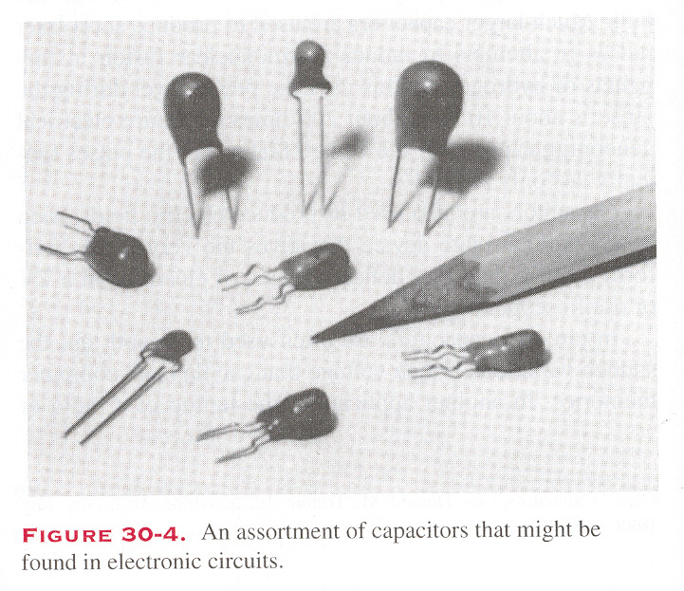
30-1 Capacitors (电容器)
1. Introduction
A capacitor is a device whose purpose is to store electrical energy which can then be released in a controlled manner during a short period of time.

Slide 4
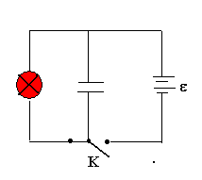
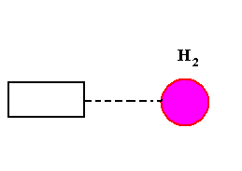
A flashbulb (闪光灯):
A capacitor can draw energy from battery (several seconds s); then can release the energy through the bulb (milliseconds, ms)
Laser pulse (激光脉冲): thermonuclear fusion (热核聚变)
The power: 10¹⁴W, about 200 times the entire electrical generating capacitor of United States
Pulses time gap: 10⁻⁹s

Slide 5
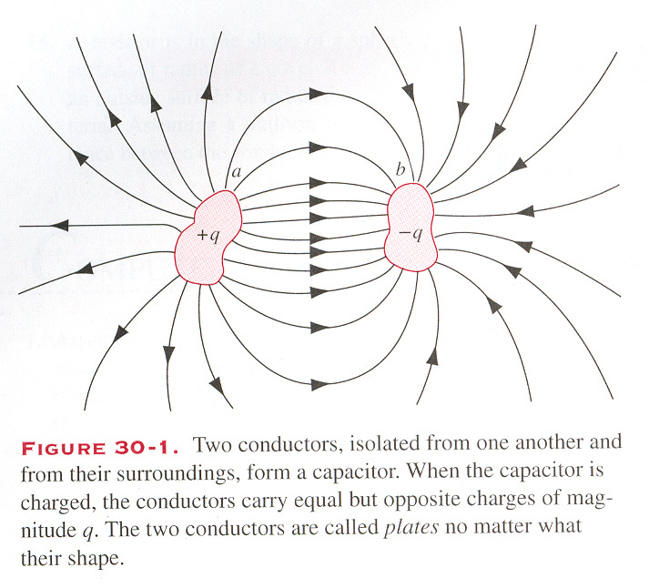
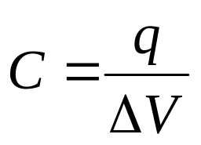
2. Definition of Capacitance (电容)
A capacitor consists of 2 spatially separated conductors which can be charged to +q and -q respectively.
The capacitance is defined as the ratio of the charge on one conductor of the capacitor to the potential difference between the conductors.
The capacitance belongs only to the capacitor, independent of the charge and voltage, depends on the shapes, relative positions the materials that fill the space between the plates.

Slide 6
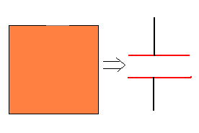
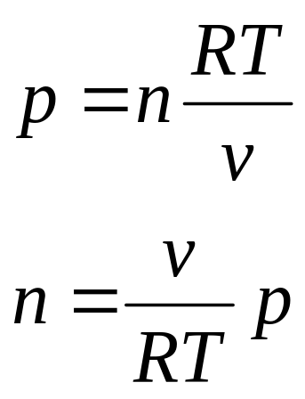
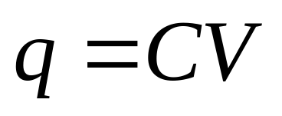
Analogy with Fluid Flow

Slide 7
3. Calculating the Capacitance
For different geometry capacitor C=?
To assume a charge q on the plates
Calculating E (Gauss’ Law)
Calculating the difference of potential between two plates ΔV
Using:
We can simplify the calculation of E, ΔV by making certain assumptions.

Slide 8
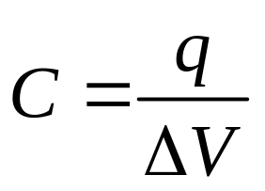
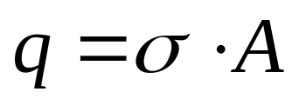
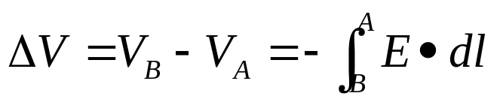
Example1: Parallel Plate Capacitor
(平行板电容器)
Calculate the capacitance. We assume +q, -q charge on each plate with potential difference ΔV:
A
+ + + +
d
- - - - -
Need q:
Need ΔV: from def’n:
  Use Gauss’ Law to find E

Slide 9
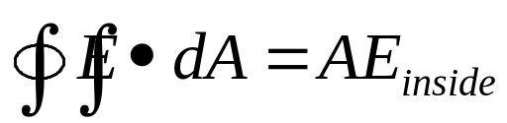
Recall: Two Infinite Sheets
(into screen)
+
-
σ
σ
+
-
Field outside the sheets is zero
E=0
+
-
E=0
+
-
Gaussian surface encloses zero net charge
+
-
A
+
-
+
-
+
-
Field inside sheets is not zero:
+
-
Gaussian surface encloses non-zero net charge
+
-
A
-
+
-
+
-
E

Slide 10
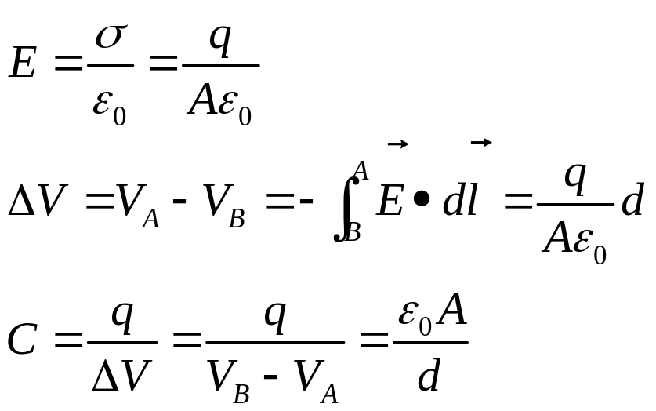
Example:
Parallel Plate Capacitor
Calculate the capacitance:
Assume +q, -q on plates with potential difference ΔV.
A
+ + + +
d
- - - - -
As hoped for, the capacitance of this capacitor depends only on its geometry (A,d).
Note that C ~ length; this will always be the case!

Slide 11
Practical Application: Microphone (“condenser”)
d
Current sensor
Battery
Moveable plate
Fixed plate
Sound waves incident
→ pressure oscillations
→ oscillating plate separation d
→ oscillating capacitance ( )
→ oscillating charge on plate
→ oscillating current in wire ( )
→ oscillating electrical signal
See this in action at http://micro.magnet.fsu.edu/electromag/java/microphone/ !

Slide 12
Example 2: Cylindrical Capacitor
(圆柱形电容器)
Calculate the capacitance:
Assume +Q, -Q on surface of cylinders with potential difference V.
r
a
b
L

Slide 13
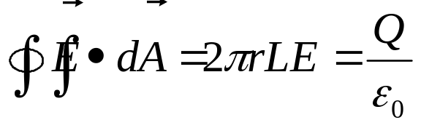
Recall: Cylindrical Symmetry
Gaussian surface is cylinder of radius r and length L
Cylinder has charge Q
E_{r}
E_{r}
Q
+ + +
+ + + +
Apply Gauss' Law:
L
⇒

Slide 14
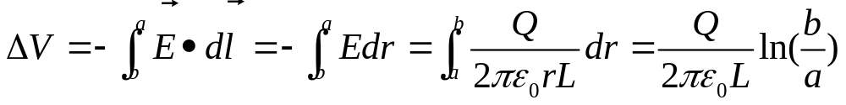

Example 2
Cylindrical Capacitor
Calculate the capacitance:
Assume +Q, -Q on surface of cylinders with potential difference V.
- Q
r
a
+Q
b
L
If we assume that inner cylinder has +Q, then the potential V is positive if we take the zero of potential to be defined at r = b:
⇒

Slide 15
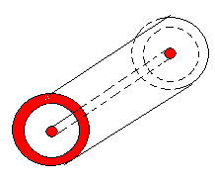
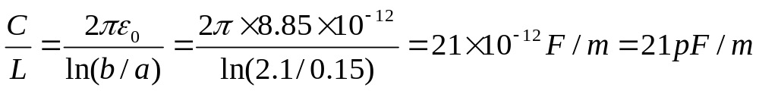
Example: TV signals transmit
(coaxial cable)
Inner radius: a=0.15mm
Outer radius: b=2.1mm
Capacitance per unit length:

Slide 16
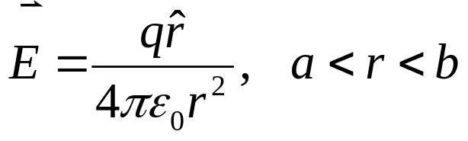
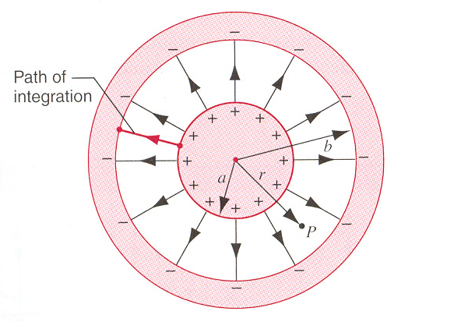
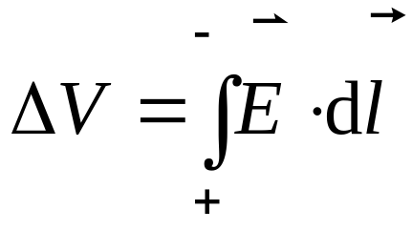
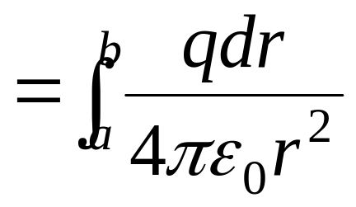
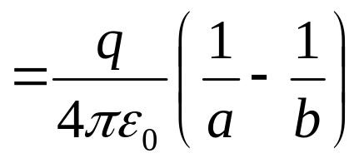
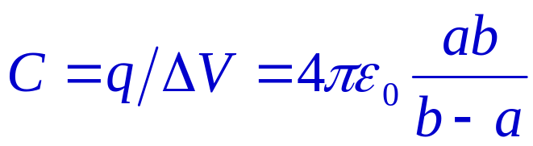
Example 3 A Spherical Capacitor
(球形电容器)

Slide 17
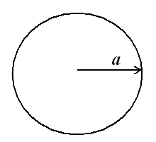
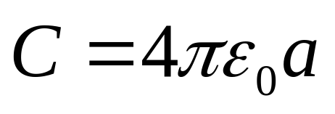
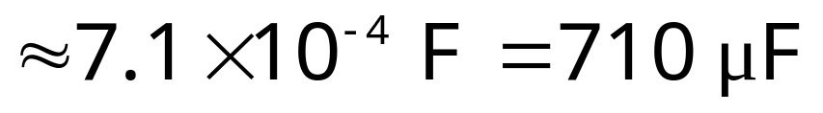
The capacitance of an isolated spherical conductor
Example:
What is the capacitance of the Earth, viewed as an isolated conducting sphere of radius R=6370km?

Slide 18
4. Capacitors in Parallel (并联)
a
a
Q₁
Q₂
≡
Q
V
C
C
V
C
1
2
-Q₁
-Q₂
-Q
b
b
Find “equivalent” capacitance C in the sense that no measurement at a, b could distinguish the above two situations.
Aha! The voltage across the two is the same….
⇒
Parallel Combination:
Equivalent Capacitor:
⇒

Slide 19
Capacitors in Series (串联)
+Q
-Q
C
+Q
-Q
2
≡
a
b
a
b
C
+Q
-Q
C
1
Find “equivalent” capacitance C in the sense that no measurement at a, b could distinguish the above two situations.
The charge on C₁ must be the same as the charge on C₂ since applying a potential difference across ab cannot produce a net charge on the inner plates of C₁ and C₂
  assume there is no net charge on node between C₁ and C₂
RHS:
⇒
LHS:

Slide 20

Examples:
Combinations of Capacitors
a
C
≡
3
a
b
C
C
C
1
2
b
How do we start??
Recognize C₃ is in series with the parallel combination on C₁ and C₂. i.e.,
⇒

Slide 21
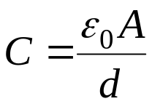
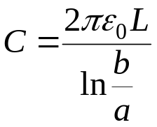
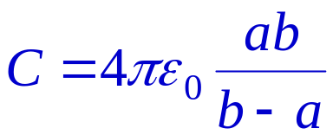
Summary
A Capacitor is an object with two spatially separated conducting surfaces.
The definition of the capacitance of such an object is:
The capacitance depends on the geometry :
-Q
A
-Q
+Q
a
r
+ + + +
a
d
+Q
- - - - -
b
b
L
Parallel Plates
Cylindrical
Spherical

Slide 22
Appendix: Another example
-Q
Suppose we have 4 concentric cylinders of radii a,b,c,d and charges +Q, -Q, +Q, -Q
+Q
-Q
b
+Q
a
Question: What is the capacitance between a and d?
c
Note: E-field between b and c is zero! WHY??
  A cylinder of radius r₁: b < r₁< c encloses zero charge!
d
⇒
Note: This is just the result for 2 cylindrical capacitors in series!

Slide 23
30-2 Energy storage in electric field
How much energy is stored in a charged capacitor?
  Calculate the work provided (usually by a battery) to charge a capacitor to +/- Q:
Calculate incremental work dW needed to add charge dq to capacitor at voltage V (there is a trick here!):
- +
The total work W to charge to Q is then given by:
Look at this!
Two ways to write W
In terms of the voltage V:

Slide 24
Capacitor Variables
The total work to charge to Q equals the energy U stored in the capacitor:
Look at this!
Two ways to write U
In terms of the voltage V:
You can do one of two things to a capacitor :
hook it up to a battery specify V and Q follows
put some charge on it specify Q and V follows

Slide 25
Question!
Suppose the capacitor shown here is charged to Q and then the battery is disconnected.
A
+ + + +
d
- - - - -
Now suppose I pull the plates further apart so that the final separation is d₁.
How do the quantities Q, U, C, V, E change?
Q:
U:
C:
V:
E:
remains the same.. no way for charge to leave.
increases.. add energy to system by separating
decreases.. since energy ↑, but Q remains same
increases.. since C ↓, but Q remains same
remains the same... depends only on charge density
How much do these quantities change?.. exercise for student!!
Answers:

Slide 26

Related Question
Suppose the battery (V) is kept attached to the capacitor.
A
V
+ + + +
d
- - - - -
Again pull the plates apart from d to d₁.
Now what changes?
C:
V:
Q:
E:
U:
decreases (capacitance depends only on geometry)
must stay the same - the battery forces it to be V
must decrease, Q=CV charge flows off the plate
must decrease ( , )
must decrease ( )
How much do these quantities change?.. exercise for student!!
Answers:

Slide 27
Where is the Energy Stored?
Claim: energy is stored in the electric field itself. Think of the energy needed to charge the capacitor as being the energy needed to create the field.
To calculate the energy density in the field, first consider the constant field generated by a parallel plate capacitor, where
- Q
- - - - - - - - - - - - - -
++++++++ +++++++
+Q
This is the energy density, u, of the electric field….
The electric field is given by:
⇒
The energy density u in the field is given by:
Units:

Slide 28

Energy Density
Claim: the expression for the energy density of the electrostatic field
is general and is not restricted to the special case of the constant field in a parallel plate capacitor.
Example (and another exercise for the student!)
  Consider E-field between surfaces of cylindrical capacitor:
  Calculate the energy in the field of the capacitor by integrating the above energy density over the volume of the space between cylinders.
  Compare this value with what you expect from the general expression:
r
-Q
a
+Q
b
L

Slide 29
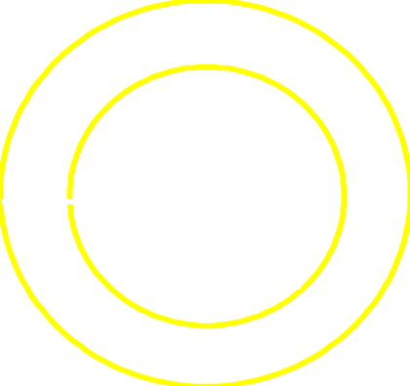
Chapter 30, ACT 2
C₁
b
a
Consider two cylindrical capacitors, each of length L.
  C₁ has inner radius a and outer radius b.
  C₂ has inner radius 2a and outer radius 2b.
C₂
2b
If both capacitors are given the same amount of charge, what is the relation between U₁, the energy stored in C₁, and U₂, the energy stored in C₂?
(Hint: what is the relationship between C₁ and C₂?)
2a
(a) U₂ < U₁
(b) U₂ = U₁
(c) U₂ > U₁
Recall that

Slide 30
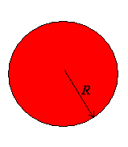
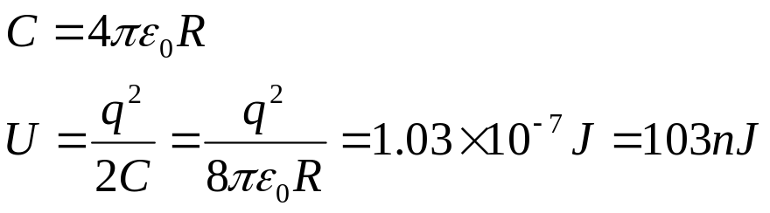
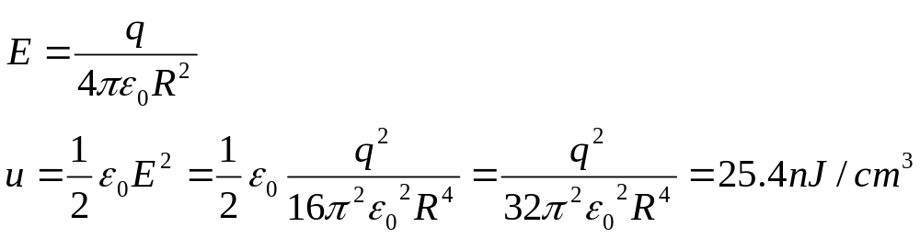
Problem 30-7 (page 687). An isolated conducting sphere whose radius R is 6.85cm carries a charge q=1.25nC. (a) How much energy is stored in the electric field of this charged conductor? (b) What is the energy density at the surface of the sphere? (c) What is the radius R₀ of the imaginary spherical surface such that one-half of the stored potential energy lies within it?
R=6.85cm, q=1.25nC
U=?
u=? (at the surface of the sphere)
R₀=? At R<R₀, U’=1/2U
Solution: (a)
(b)

Slide 31
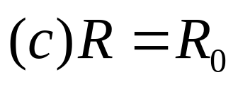
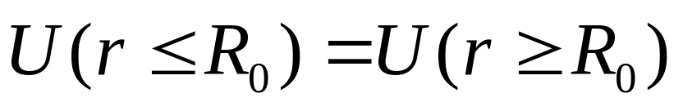
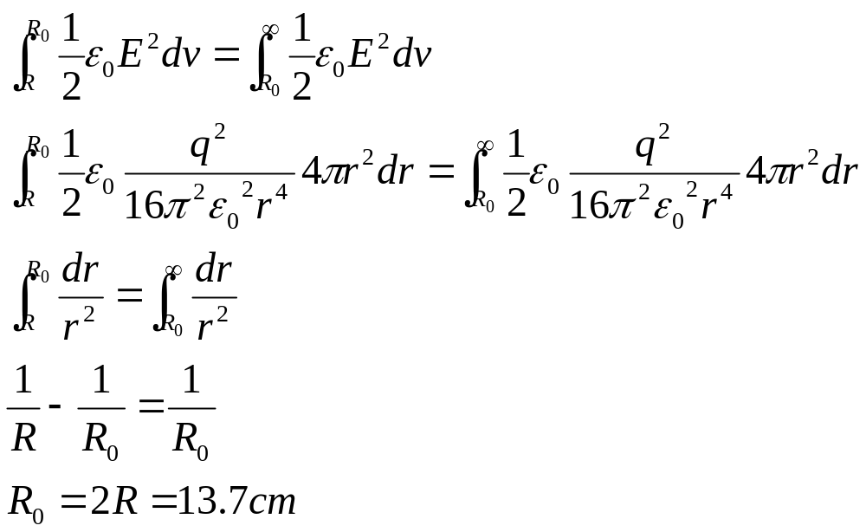

Slide 32
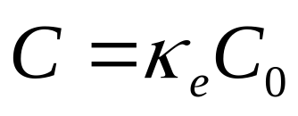
30-3 Dielectrics
（电介质，电场中的绝缘体）
1. Capacitor with dielectrics
Empirical observation:
Inserting a non-conducting material between the plates of a capacitor changes the VALUE of the capacitance.
Definition:
The dielectric constant (介电常数) of a material is the ratio of the capacitance when filled with the dielectric to that without it:
  κ_{e} values are always > 1 (e.g., glass = 5.6; water = 78)
  They INCREASE the capacitance of a capacitor (generally good, since it is hard to make “big” capacitors)
  They permit more energy to be stored on a given capacitor than otherwise with vacuum (i.e., air)

Slide 33

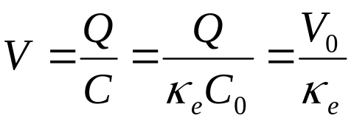
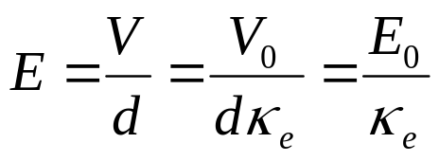
Parallel Plate Example I
Q
Deposit a charge Q on parallel plates filled with vacuum (air)—capacitance C₀.
The potential difference is V₀ = Q / C₀.
+++++++++++++++
V
0
E
0
- - - - - - - - - - - - - - -
Now insert material with dielectric constant κ_{e} (介电常数).
  Charge Q remains constant
  Capacitance increases C = κ_{e}C₀
  Voltage decreases from V₀ to:
Q
+++++++++++++++
-
-
-
V
-
E
-
-
+
+
+
+
+
+
-
+
- - - - - - - - - - - - - - -
  Electric field decreases also:

Slide 34
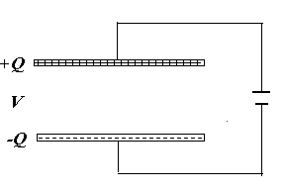
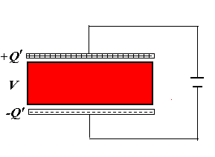
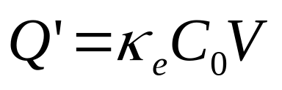
Parallel Plate Example II
A charge Q on parallel plates filled with vacuum (air) and with the battery connected —capacitance C₀.
The charge Q = C₀V.
Now insert material with dielectric constant κ_{e} .
  The voltage remains constant
  Capacitance increases C = κ_{e}C₀
  Charge increases from Q to:

Slide 35
Some properties of dielectrics
(Paper 671)
Material Dielectric Constant κ_{e} Dielectric strength (kV/mm)
Vacuum 1 (Exact)
Air 1.00059 3
Polystyrene (聚苯乙烯) 2.6 24
Paper 3.5 16
Transformer oil 4.5 12
Pyrex (硼硅酸玻璃) 4.7 14
Mica(云母) 5.4 160
Porcelain(瓷) 6.5 4
Silicon(硅) 12
Water(25ºC) 78.5
Water(20ºC) 80.4
Titania ceramic(TiO₂) 130
SrTiO₃ 310 8

Slide 36
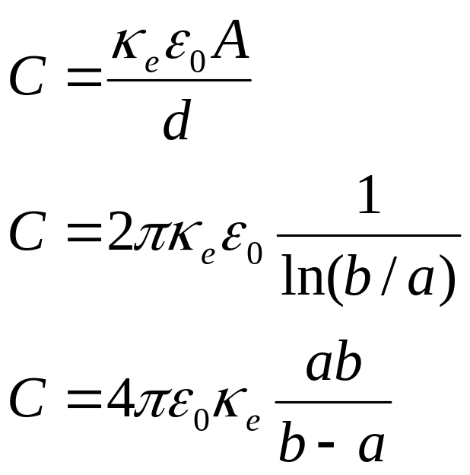
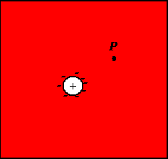
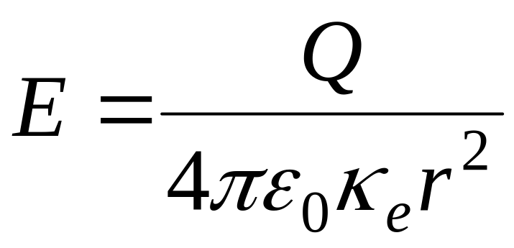
After introducing κ_{e}
For a parallel-plate capacitor:
For a cylindrical capacitor:
For a spherical capacitor:

Slide 37
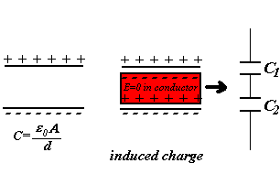
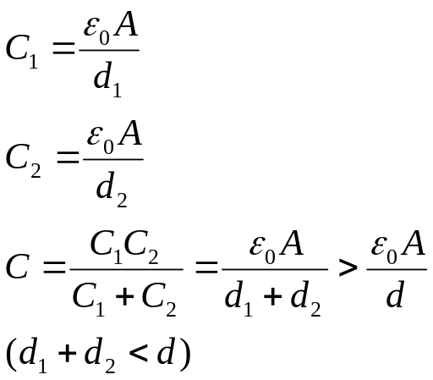
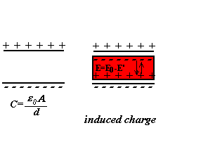
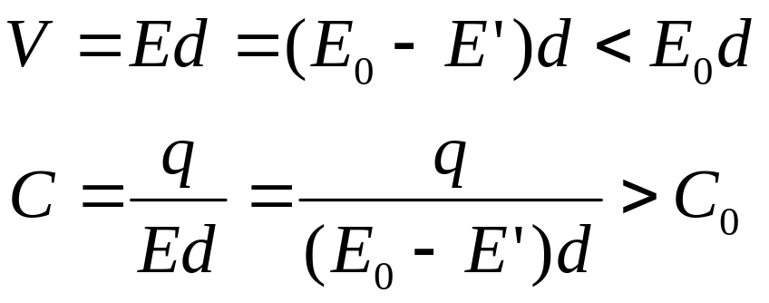
How to understand the increase of C: (Macroscopic宏观理解)
The presence of conductor in a capacitor
The redistribution of charge in a C
The presence of a dielectrics
Polarization (极化)

Slide 38

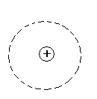



2. The microscopic mechanism of polarization of dielectrics (极化的微观机理)
Dielectrics:
Non-polar dielectrics (无极分子电介质)
Such as: H₂, N₂, CCl₄ CO₂
Polar dielectrics (有极分子电介质)
Such as: H₂O

Slide 39



The non-polar dielectrics (无极分子电介质): in an electric field
Induced electric dipole moment (感生电偶极矩)
Electric displacement polarization (电子位移极化)

Slide 40







Polar dielectrics (有极分子电介质) in an electric field
Alignment polarization (取向极化）
Notes: In high frequency field, Electric displacement polarization (电子位移极化) plays an important role.

Slide 41




3. Polarization (极化强度矢量P）
Definition
In the volume of ΔV
Unit: C/m²
Uniform,
Or non-uniform

Slide 42





Relationship between P and σ’
For uniform dielectrics
The induced charge distributes only
on the surface of dielectrics.
For displacement polarization
Consider the positive induced charge through area dA due to polarization.
n, the number of molecular per unit volume

Slide 43








Slide 44




4. Depolarization Field (退极化场）
Depolarization field E’
At some place, in the same direction.
At another place, in the opposite direction

Slide 45





Example 1
A spherical dielectrics, uniform polarization P
σ_{e}’=Pcosθ
Calculating the depolarization field E’ (退极化场) at center.

Slide 46


Example 2
Parallel plate:

Slide 47




5. Polarization law of dielectrics (电介质的极化规律)
For different materials, different and complicated, which is determined by an experiment result.
For general isotropic materials (各向同性)
χ_{e}: Polarization coefficient (极化率)
κ_{e}=1+ χ_{e}

Slide 48




For some crystal materials
(anisotropic,如SiO₂晶体水晶等)
张量

Slide 49

For other materials: Ferroelectric material
(铁电体)
Such as:
BaTiO₃; NaKC₄H₄O₆.4H₂O(酒石酸钾)
Electric hysteresis effect (电滞效应）
Similar to the magnetic hysteresis effect. (磁滞效应）
信息存储器

Slide 50



6. Electric Displacement Vector D (电位移矢量) and Gauss’ Law with Dielectrics.
In dielectrics:
very complicated
Induce a new physical quantity:
Electric Displacement Vector (电位移矢量)
Or Electric Induction Vector (电感应矢量)

Slide 51




Electric Displacement Vector D
Gauss Law in the dielectrics

Slide 52




Electric Displacement Vector (电位移矢量)
Dielectric constant(介电常数）
Polarization Coefficient (极化率)

Slide 53



Example
Example 1
In conductor

Slide 54


Example 2
Note:
Why?

Slide 55




7. Pressure-Electric Effect (压电效应）
Such as: 石英(SiO₂); 电气石;
酒石酸钾钠(NaKC₄H₄O₆.4H₂O); BaTiO₃

Slide 56
Applications
1. 压电效应
晶体振动器：扩音器，电唱头：机械振动 电振动，f 稳定；石英钟, 2×10⁻⁵s/day
2. 电致伸缩
电话耳机，超声波的产生：电振动 机械振动，f>20000Hz
超声马达：1973年提出，80年代迅速发展，90年代微机器人
超声清洗，超声焊接，超声检测，超声成像等已发展成为一个很大的产业！

Slide 57


Physics in life: Why Salt Dissolves
Normally NaCl is in a rigid crystal structure, maintained by the electrostatic attraction between the Na⁺ and Cl⁻ ions.
Water has a very high dielectric constant (78). This reduces the field between the atoms, hence their attraction to each other. The crystal lattice comes apart and dissolves.
Note: This should leave lots of ions in the water

Slide 58
Homework
Page 676, 29,
Page 695, 19,
Page 697, 8, 16, 24

